Slide 1

"Classification of Chest X-rays: Identifying Infected vs. Normal Images"
TEAM MEMBER
Muhammed Osama Attia Ahmed
Ihab Mostafa Abdelmounem Goma
Ahmed Mohamed Abdo Elsady

Slide 2
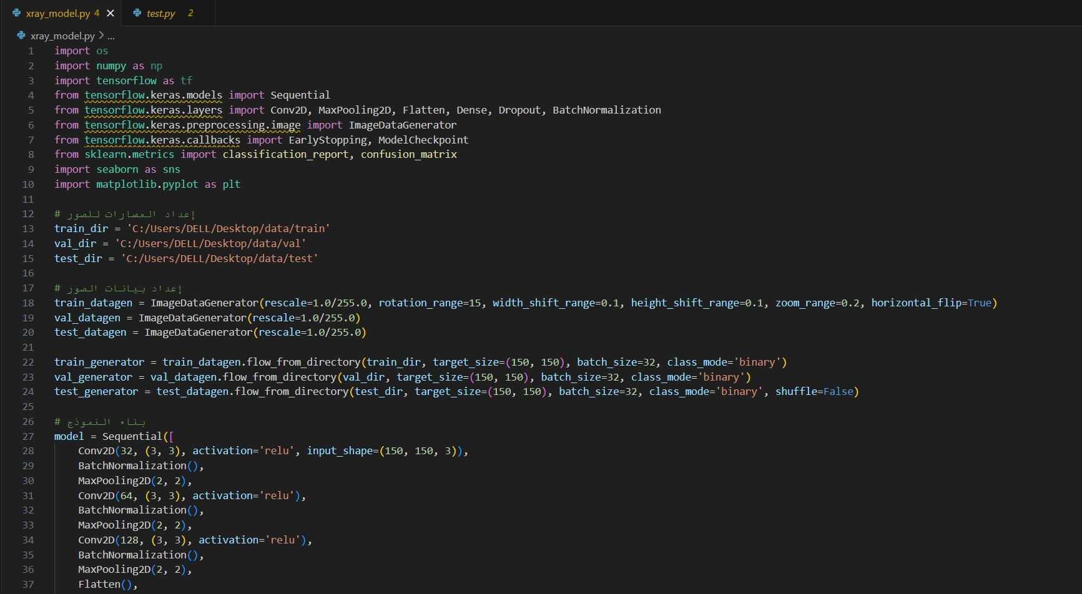

Slide 3
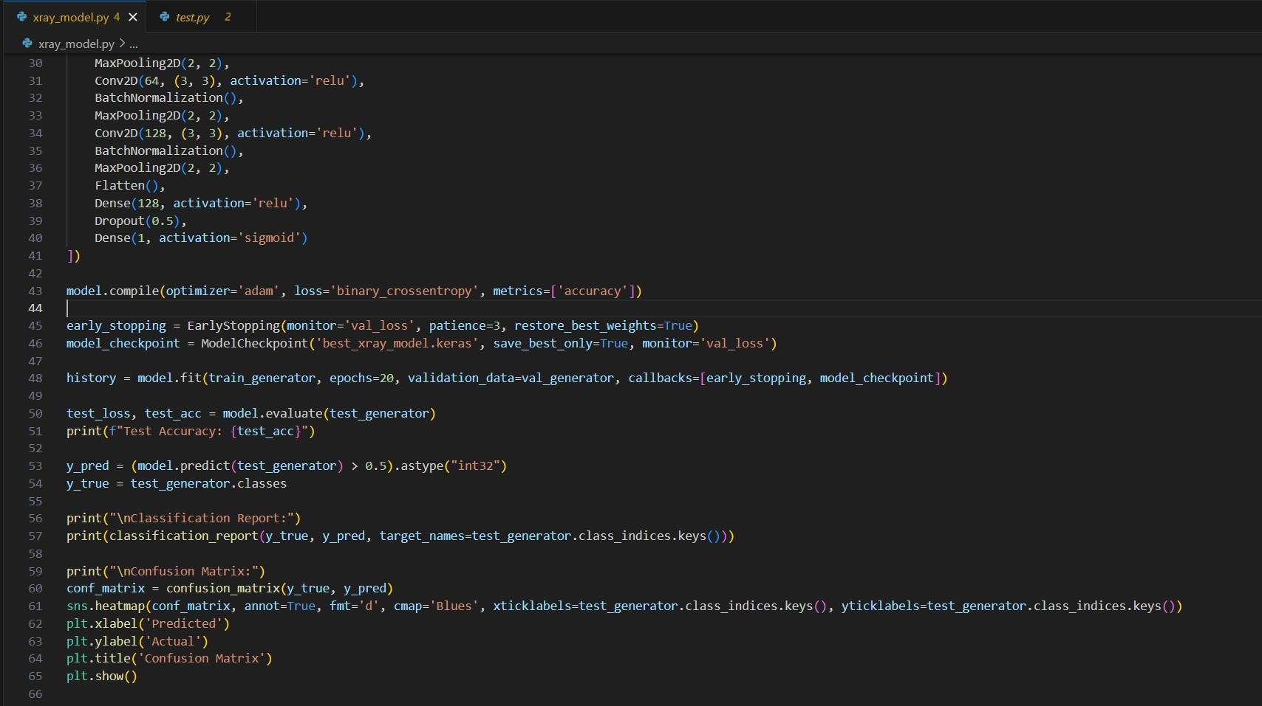

Slide 4
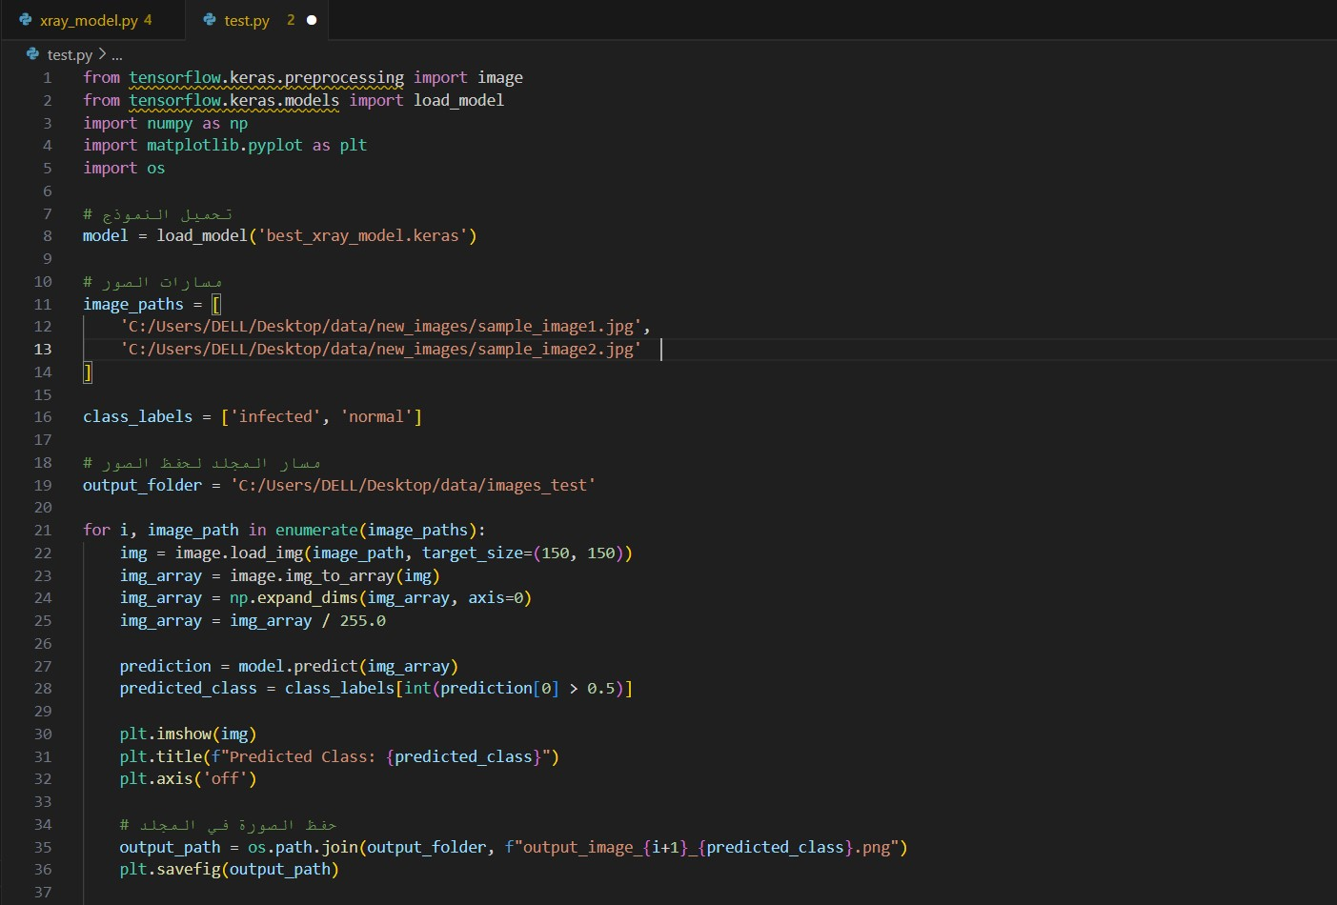

Slide 5
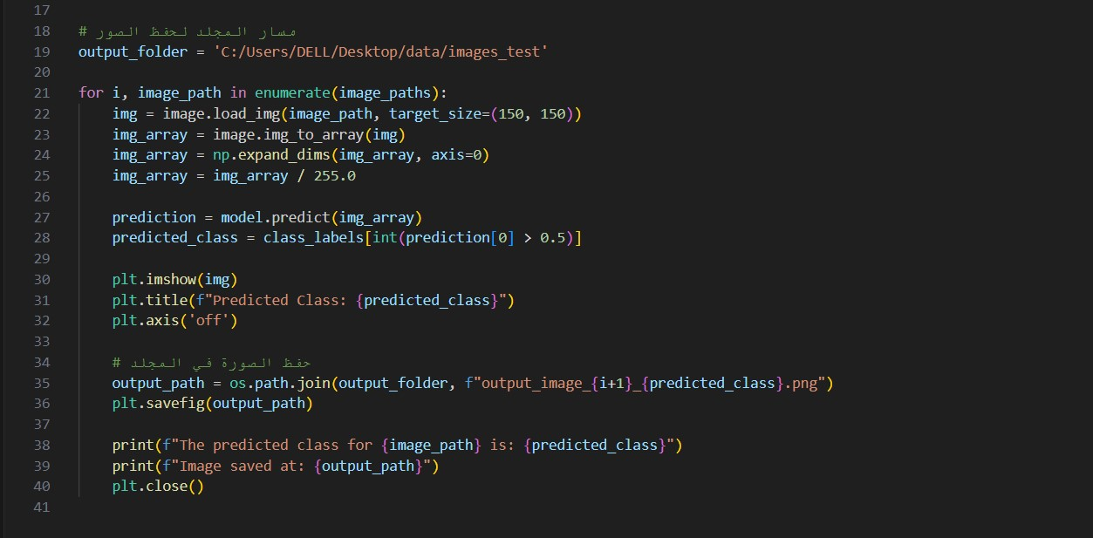

Slide 6
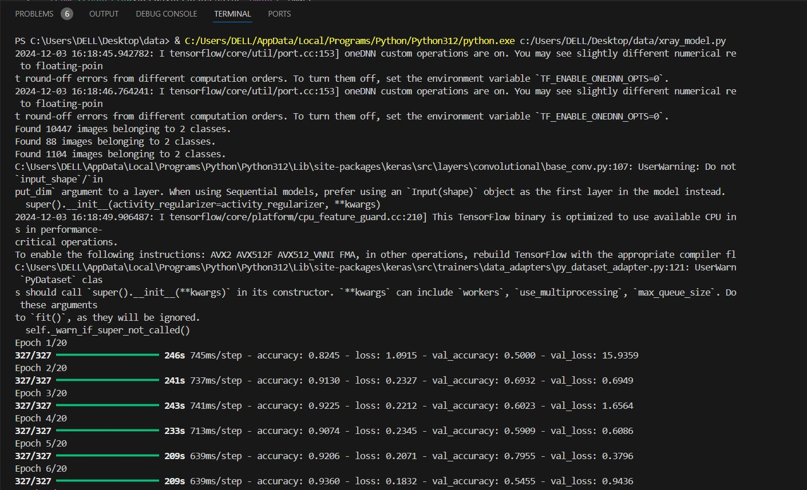

Slide 7
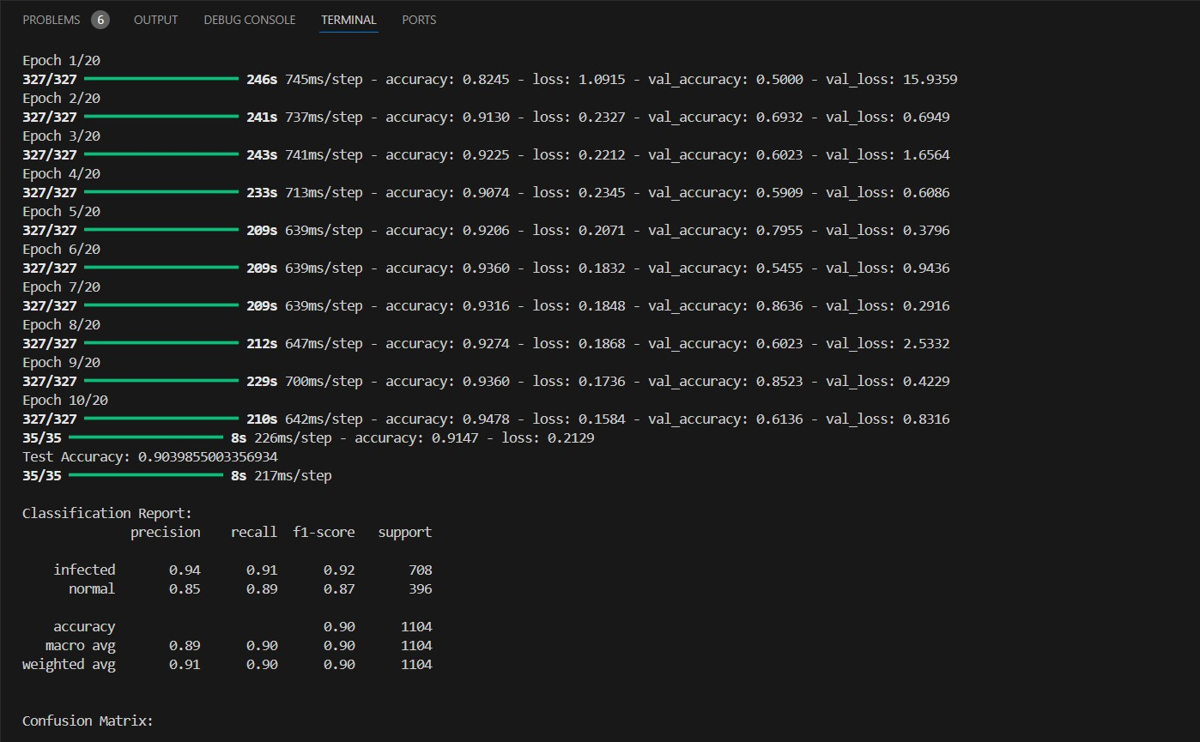

Slide 8
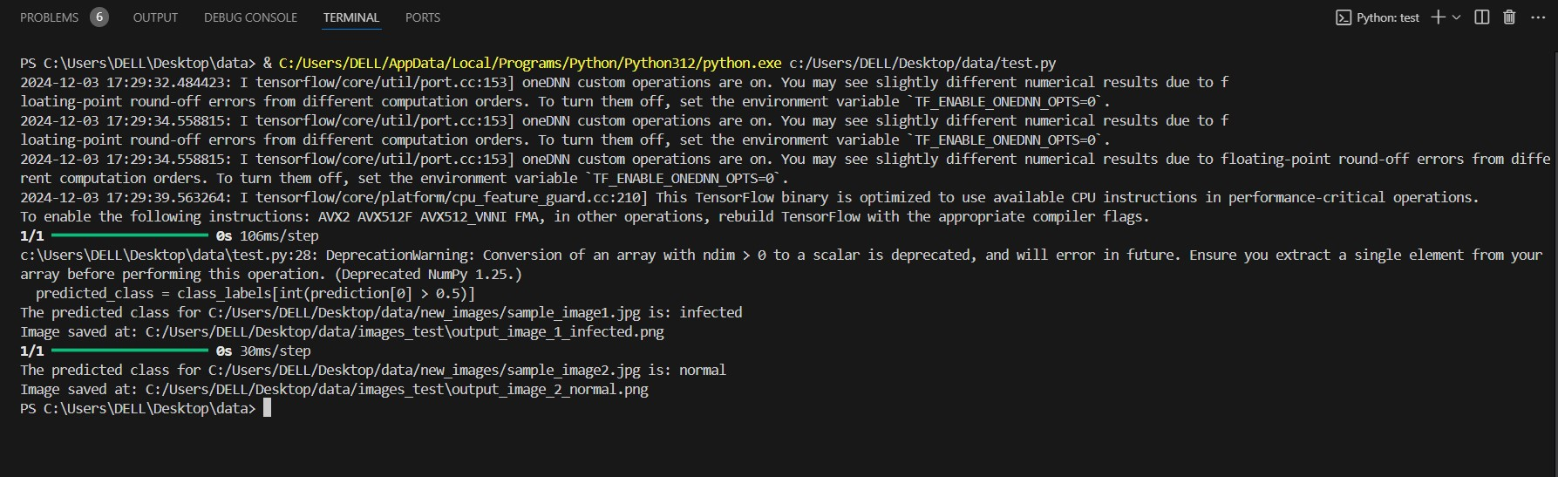

Slide 9
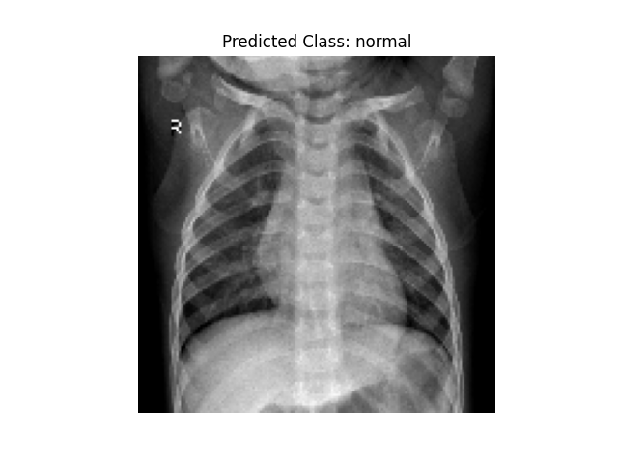
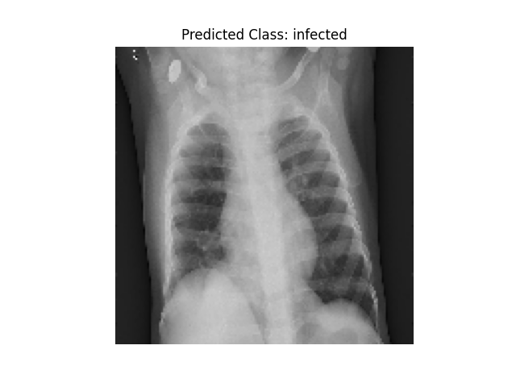
Links of kaggle
https://www.kaggle.com/datasets/tolgadincer/labeled-chest-xray-images
https://www.kaggle.com/datasets/paultimothymooney/chest-xray-pneumonia/data

Slide 10
Thank you

